Slide 1
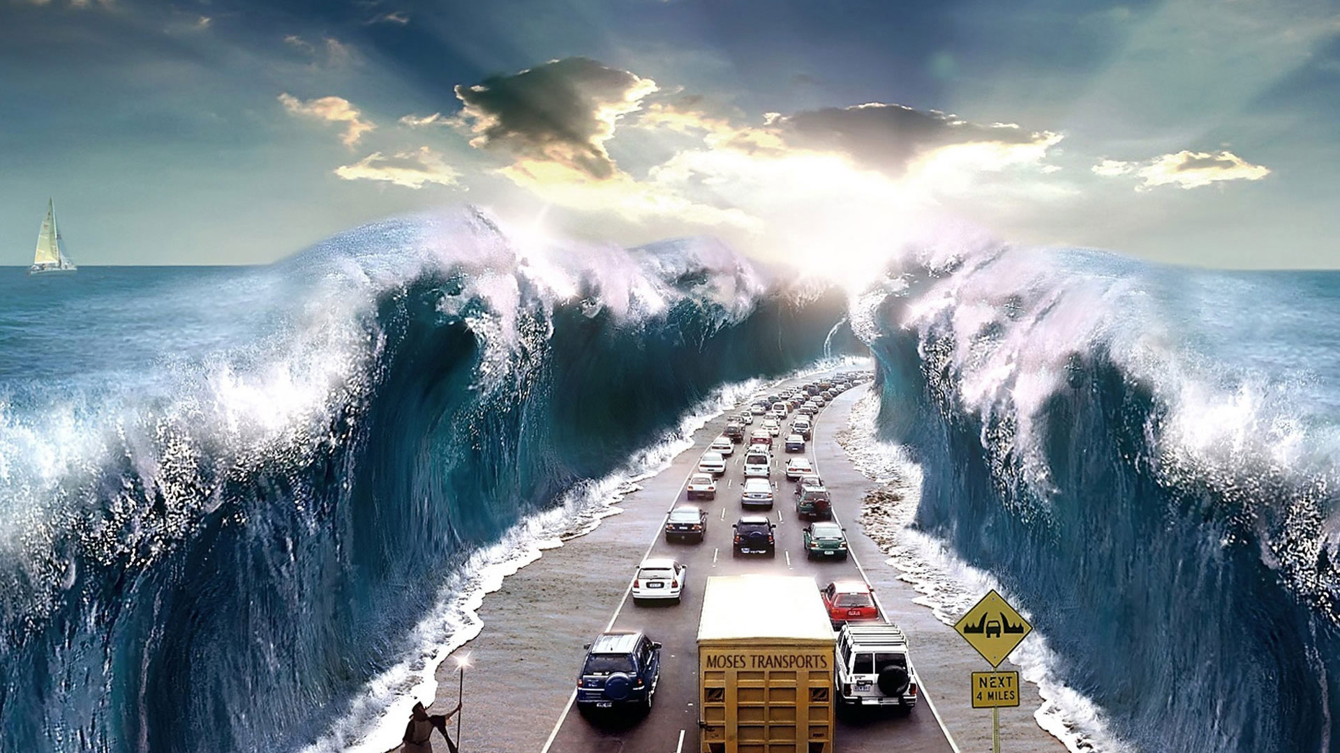
Flood

Slide 2
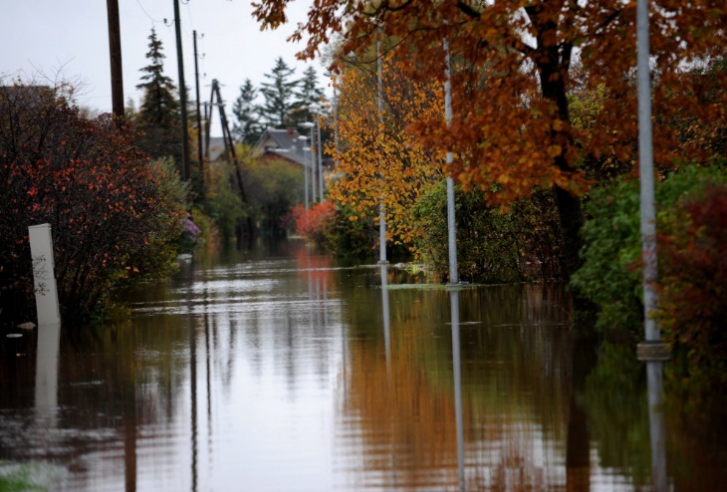
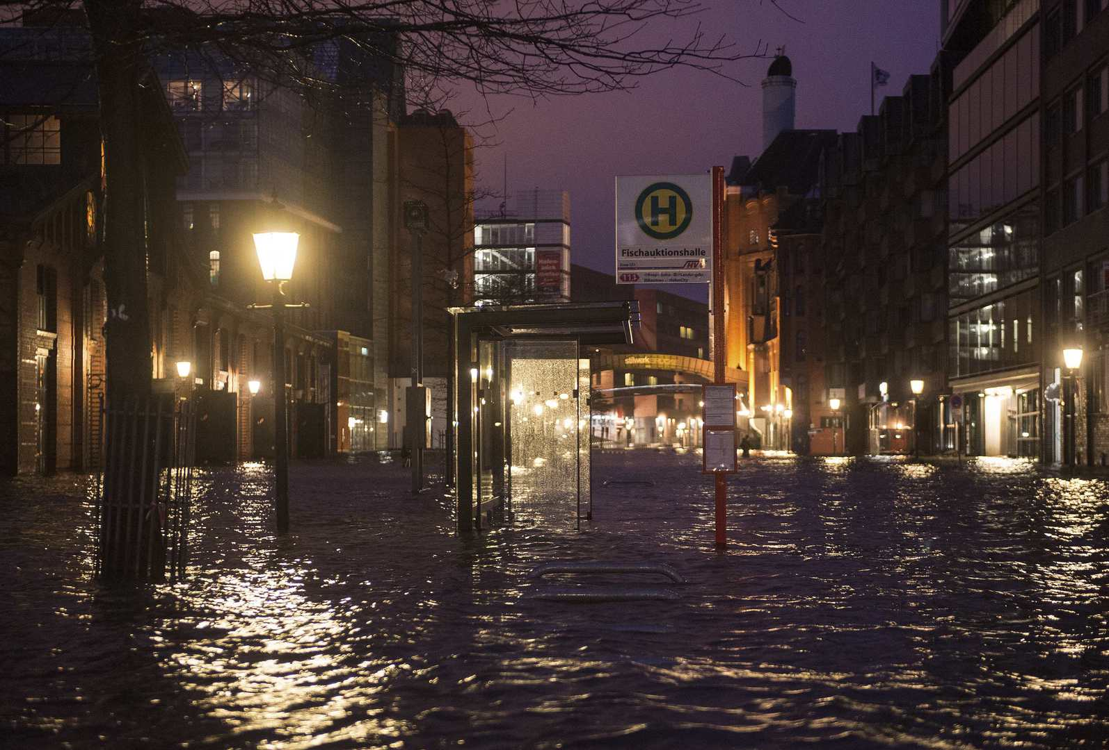
What is it?
Natural disaster, flooding of land with water.
Usually it happens either when it rains, or when the snow melts. But there are other causes of flooding.

Slide 3
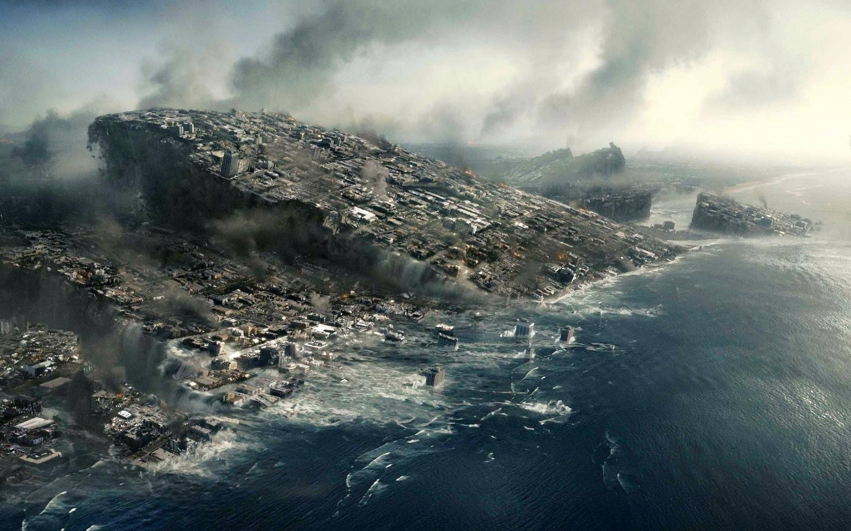
Can’t predict..
Water is not only a liquid that is needed for a person to live, but also a destructive force that can demolish cities from the earth for some hours. Seismologists, people who study hurricanes and earthquakes, can predict when and where they will be, can’t predict flooding.

Slide 4
Causes of floods:
Long rains. Mainly in summer and autumn, in regions with a high humidity.
The melting of the snow. There are a lot of snow in the spring. Because of the warming, it melts, and this water can flood everything around.
Tsunami. The tsunami wave brings a huge amount of water, which causes flooding. But it is not for long.
Destruction of dams. If the dam is for some reason unable to contain the pressure of water, a breakthrough takes place.
Natural phenomena. For example, earthquakes can block the riverbeds.

Slide 5
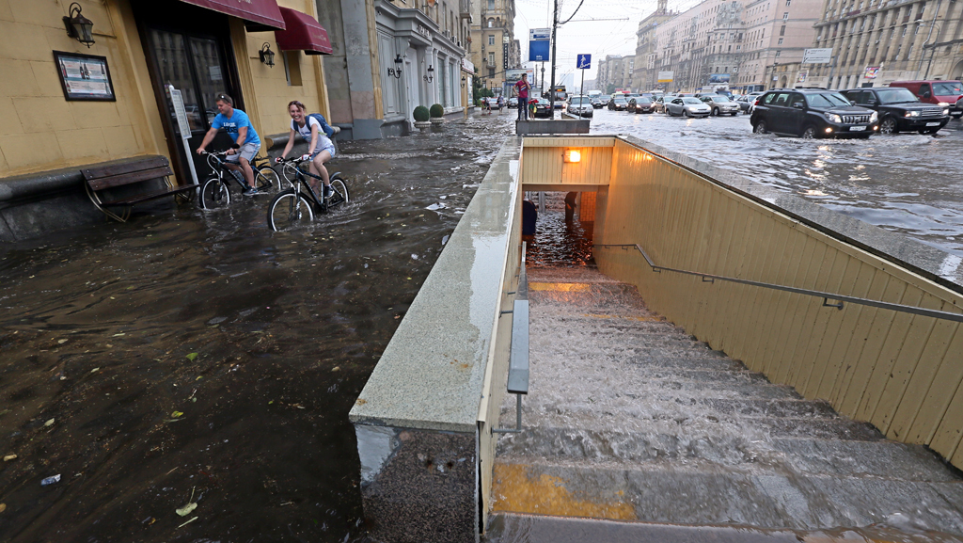
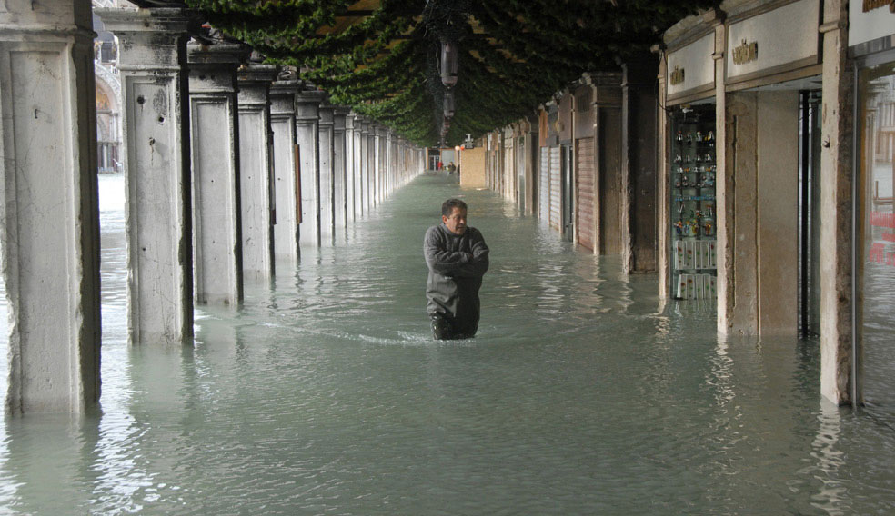
Types of floods:
«Половодье» is a long rise of water in the rivers, caused by precipitation or melting snow. Can lead to disastrous consequences.
«Паводок» is a strong but short-term rise in water level, also caused by the melting of snow or precipitation, but very powerful.
«Затор» - blockage of the river bed, leading to the flooding of areas.
«Ветровой нагон» (Wind surf) - a short (in time), but a strong flood, caused by a strong wind.
- Other types. Caused by a variety of reasons.

Slide 6
Consequences of flooding
Most floods are weak. They do not cause much material damage. Also, seldom can lead to the evacuation of people. In general, such floods do not pose a danger.
Sometimes there are very strong or even catastrophic floods. They are capable of flooding cities, causing huge material damage. In such cases mass evacuation of the population is carried out, but still people often die. Fortunately, such dangerous flooding occurs quite rarely.

Slide 7
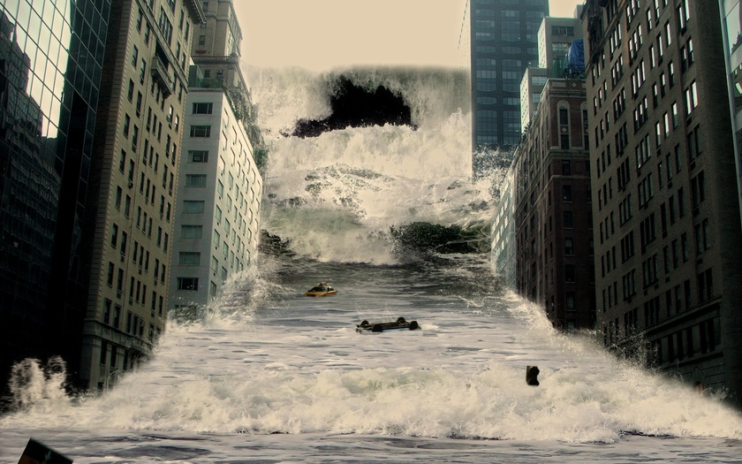
Thank you for your attention

