Slide 1
Earthquake

Slide 2
Types
There are several different kinds of quakes:
-Tectonic -Volcanic eruptions -Meteor impacts -Underground explosions -Collapsing structures

Slide 3
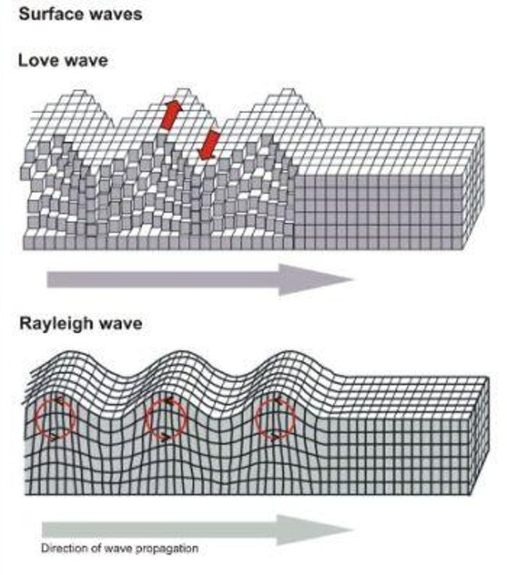
Waves
Surface waves:
Love waves
Rayleigh waves

Slide 4
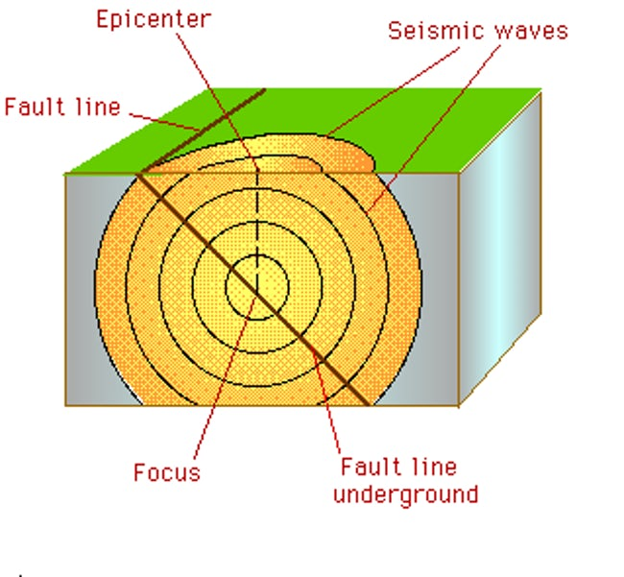
The Epicenter

Slide 5
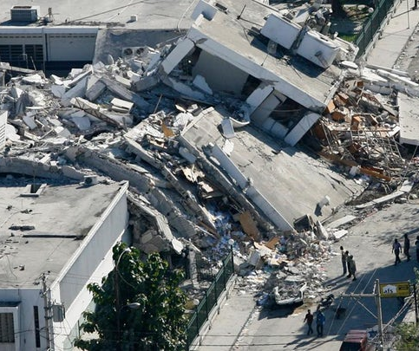
Damage

Slide 6
Thank you for your attention

